Slide 1
Keeping Your Child Engaged Over the Summer
Deborah Middleton,
Mei Chau, & Jenny Sora

Slide 2
Overview
Learn about activities you can do with your child over the summer to prepare them for the next grade and the many programs (some free!) available to NYC children.

Slide 3
Art: Here are some ideas
Go to galleries around NY-Chelsea, Lower East Side, Brooklyn
Check out museum programs and their family events, they are often free
Art Summer Camps offered through local museums-check the Guggenheim, or Whitney
Public art installations in our city parks
Encourage your child to keep a sketchbook
Do an art project with your child-get some supplies at Michaels, or another art supply store-look on Pinterest for ideas

Slide 4
Art: Examples...
When looking at art with your child…
Think about looking through your child’s eyes…
Ask, “open ended questions:” What are you wondering?
How do you think the artist created this piece”? What story do you think the artist is telling us?
Have your child bring a sketchbook with him/ her-and sit right in the gallery, or museum to draw in response to what they sees.

Slide 5
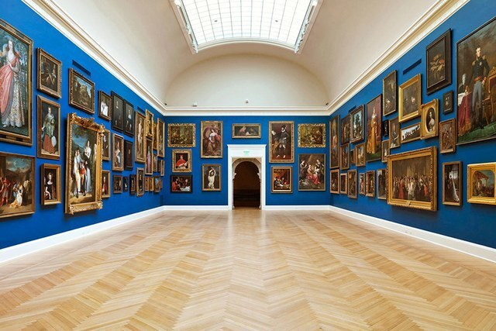
Art
There are numerous galleries in and around New York, not just in Chelsea! Galleries are always free to the public-just check hours and what’s on view.
The Brooklyn Museum offers a free “First Saturday,” of each month-great family activities. Many of the other museums in the city offer similar programs.
There are special children’s programs at museums such as the Metropolitan, the Whitney and the Guggenheim. Much of this information is available in Time Out New York, which is free on Wednesdays, or in the back of New York Magazine, and there are other publications as well.
There’s a great museum downtown, the Children’s Museum of Art.

Slide 6
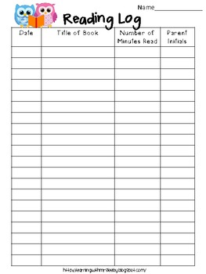
ELA - Reading
Set aside a consistent time for reading each day
Students should be reading leveled books (Scholastic Summer Reading Challenge) https://www.scholastic.com/summer/home/
Reading beyond books (Magazines, Articles etc.)
Comprehension Questions (Literal and Inferential)
Retell (fiction) and main idea (non-fiction)
Summer reading logs
Library visits - checking out books, summer reading program
Barnes and Noble - similar program
LINK: https://www.developgoodhabits.com/reading-log-template/

Slide 7
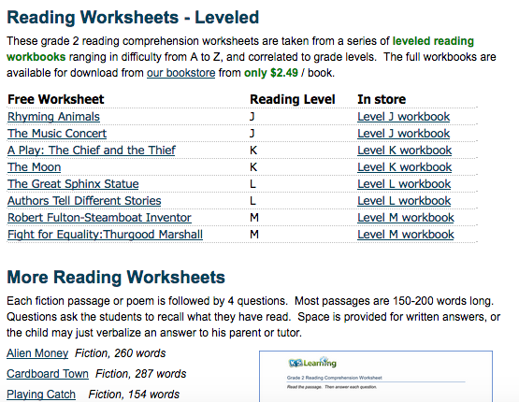
Leveled Reading
https://www.k5learning.com/reading-comprehension-worksheets

Slide 8
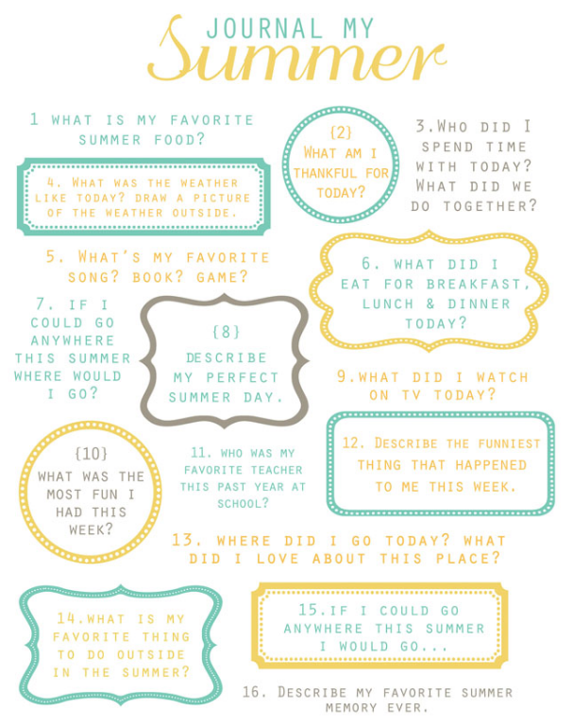
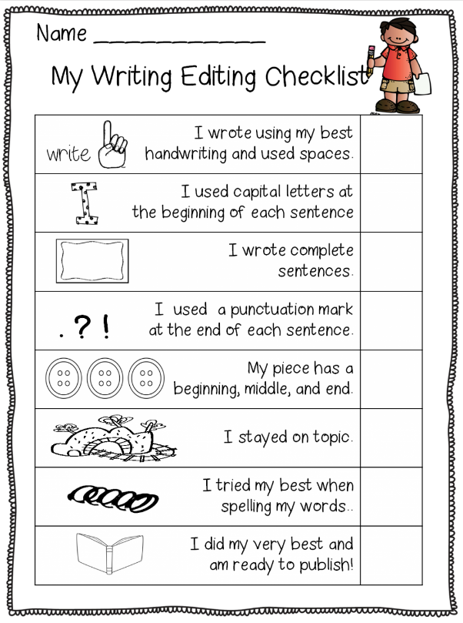
Writing
Summer Journal
Opinion: Stating opinions, convincing, providing reasons and examples, letters to friends, family, teacher.
Non-fiction (How to, All about, Scientific Method)
Narrative - Write a small moment by zooming in on a specific event, storytelling summer adventures, writing character series.
Editing Checklist

Slide 9
Literacy and Art Connection 1
Make a Vacation journal with pictures or photos you took.
Personalize it!!! Write about your adventure.
Make a pop-up sketch book that includes writing (quotes,thoughts, speech bubbles, memorabilia from a trip etc.
Pick one character from a book and write your own story, illustrating each page as you write. (Narrative/Non-Fiction or Fiction)
Make puppets from a story you read and write a new narrative. Retell your story to friends and family using puppets. (Oral Language Development)

Slide 10
Literacy Art Connection - 2
I.E. Three Billy Goats Gruff - Create a “problem” in the story after the goats went over the Bridge. (Not sharing the grass,middle goat teasing the younger one) Make puppets fromsocks, brown paper bags or
Write the script for their new version and act out the story with puppets. How did they solve the problem?
Read the book Odd Velvet (theme: accepting differences) Discuss the characters in the book and focus on their inner feelings. Search for synonyms that describe the same feelings.
Make a synonym wall or area in your house of index cards

Slide 11
Math
During the summer children should be aware of math around them and incorporating math into everyday activities.
Cooking in the kitchen - Use recipes as an incentive to review measuring, fractions etc.
Shopping - Children should shop with a specific amount of money, a list of groceries and determine how much change will be given. Students can keep their own “shopping journals” and write number sentences to reflect their shopping. Use different strategies (place value, near doubles, make a ten, number bond, chart, pictures) to find the answer.
Math Journals - Review math concepts taught throughout the year. Math website from NYSED will help. EngageNY.org

Slide 12
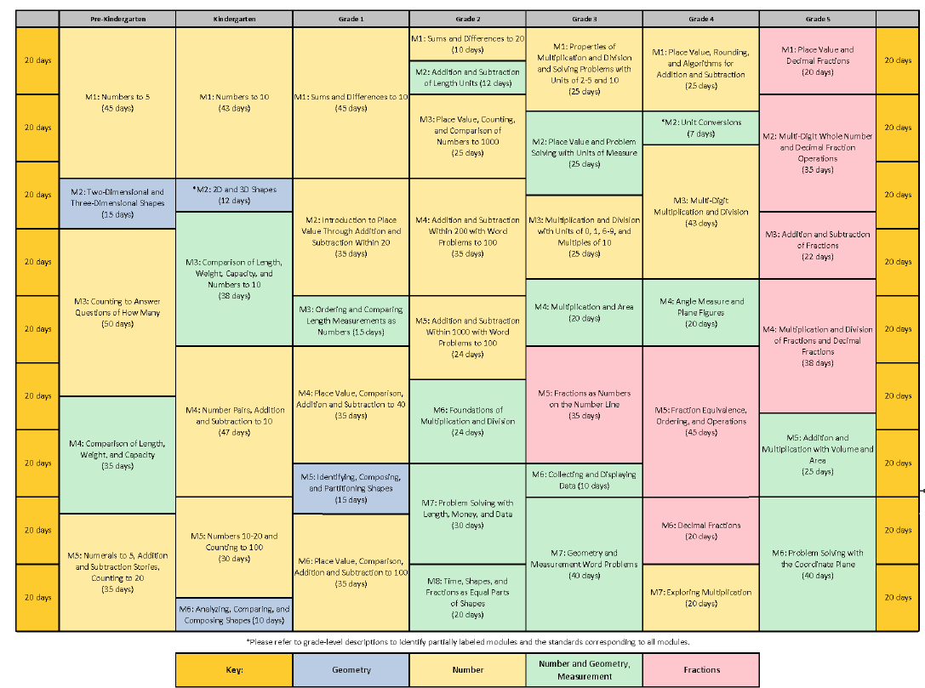
EngageNY.org

Slide 13
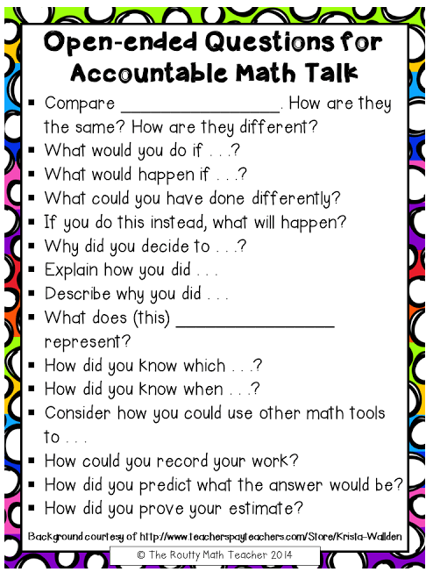
Math continued...
Make flash cards to increase fluency with all the math strands. Make sure you take them with you on your vacation!
Look for moments to have “math talks” while walking in the park, traveling, etc.
Review Math Strategies for addition, subtraction, multiplication, and division taught throughout the year.

Slide 14
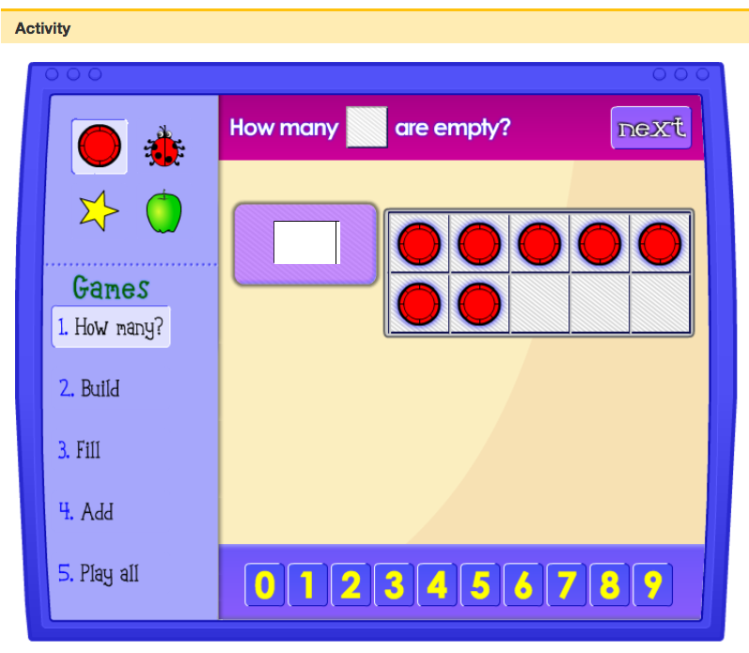
Math Resources
EngageNY.org is a NY State website based on the Math Common Core Standards, and has the curriculum (with concepts) for all grades from K-5
Make a Rekenrek: ( a math tool )
https://www.k-5mathteachingresources.com/how-to-make-a-rekenrek.html Five Frames Game http://illuminations.nctm.org/Activity.aspx?id=3564
Ten Frames Game http://illuminations.nctm.org/Activity.aspx?id=3565
Zearn.org

Slide 15
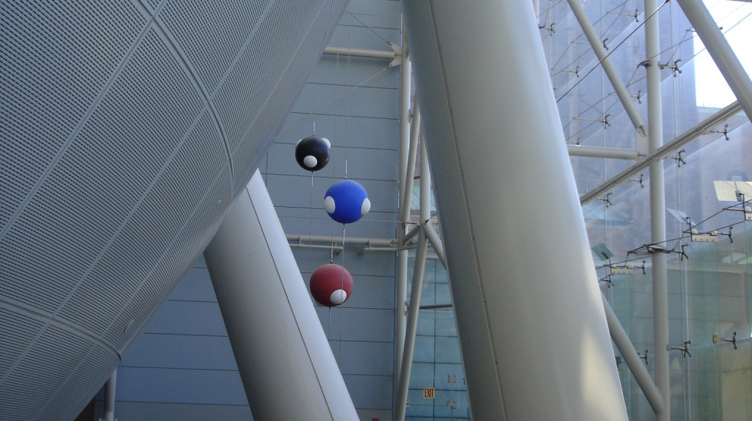
Science Museums Around Town
Museum of Natural History – has a discovery center
Liberty Science (New Jersey)
New York Hall of Science ( Queens)
New York Aquarium
Intrepid Sea, Space Museum

Slide 16
Keep a Science Journal/ Exploring Insects
Insectlore.com
Petco
Lakeshore Learning.com (Experiment Journal)
* draw a picture/ diagram
*Explanation (What I did, What I saw, What Happened, What I learned)
*glossary

Slide 17
Simple Science Experiments at Home / Math Connection Measurements
Simple Science Experiments at home
http://www.sciencefun.org/kidszone/experiments/

Slide 18
Science Books to Read
The Everything Kids’ Science Experiment by Tom Robinson
The Curious Kid Science Book by Asia Citro
Kitchen Science Lab for Kids by Liz Lee Henecke
365 Science Activities by Minna Lacey

Slide 19
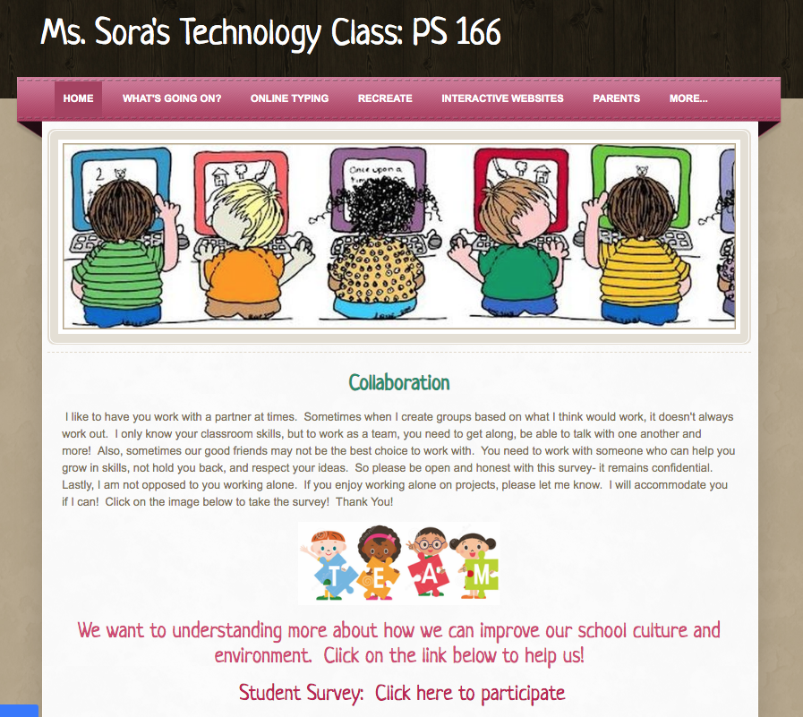

Slide 20
Ms Sora’s Website

Slide 21
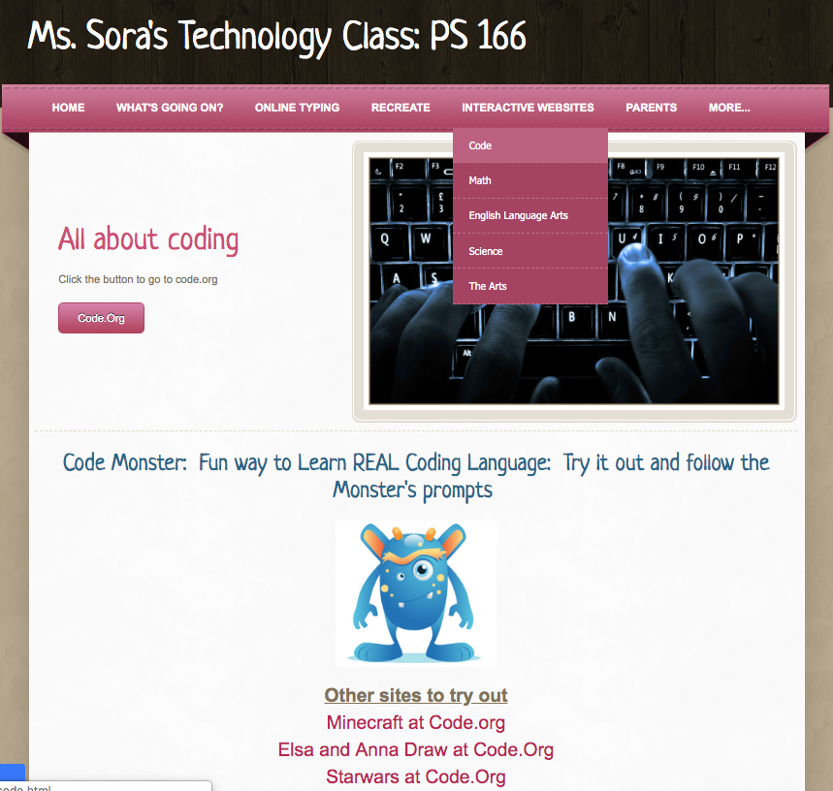

Slide 22
