Slide 1
Parent Workshop
December 8, 2015
Jenny Sora

Slide 2
What is “Hour of Code”?
The Hour of Code is a one-hour introduction to computer science, designed to demystify code and show that anybody can learn the basics.
The goal is for tens of millions of students to try an Hour of Code during December 7-13, in celebration of Computer Science Education Week
https://hourofcode.com/us

Slide 3
Understanding the Terms
Computer Science
Every student should have the opportunity to learn computer science. It helps nurture problem-solving skills, logic and creativity. By starting early, students will have a foundation for success in any 21st-century career path https://hourofcode.com/us
Terms
Code
Programming
Debugging
Code Blocks on code.org (and other sites)
How can we motivate our students to enjoy learning?

Slide 4
K-2nd Grade
Activities Students Participate during Hour of Code

Slide 5
Flappy Bird
Tinker
Lightbot

Slide 6
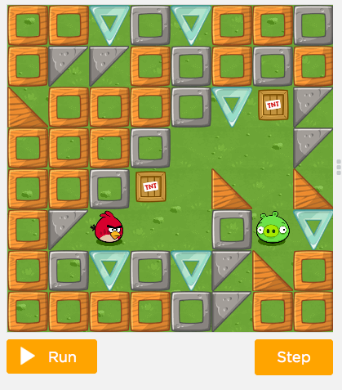
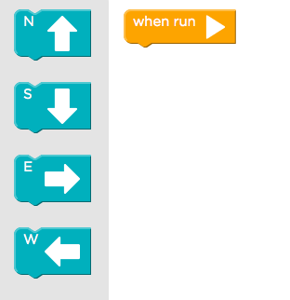
Kindergarten-First: Flappy Bird
Students learn how to program the flappy bird to get to the pig through a series of instruction. Students learn how to drag and drop

Slide 7
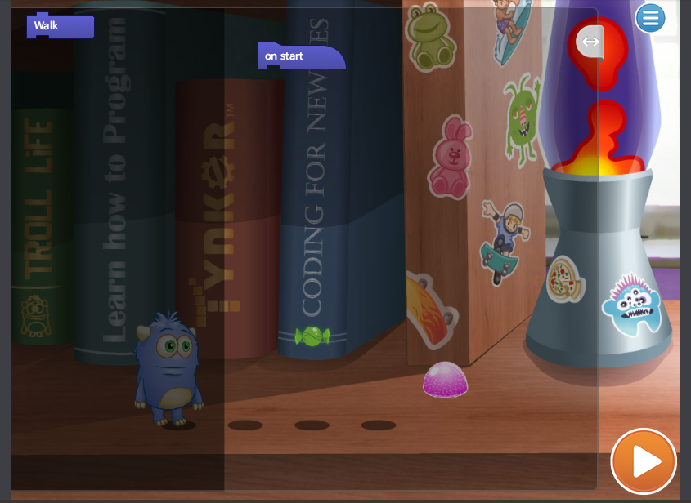
Kindergarten-1st

Slide 8
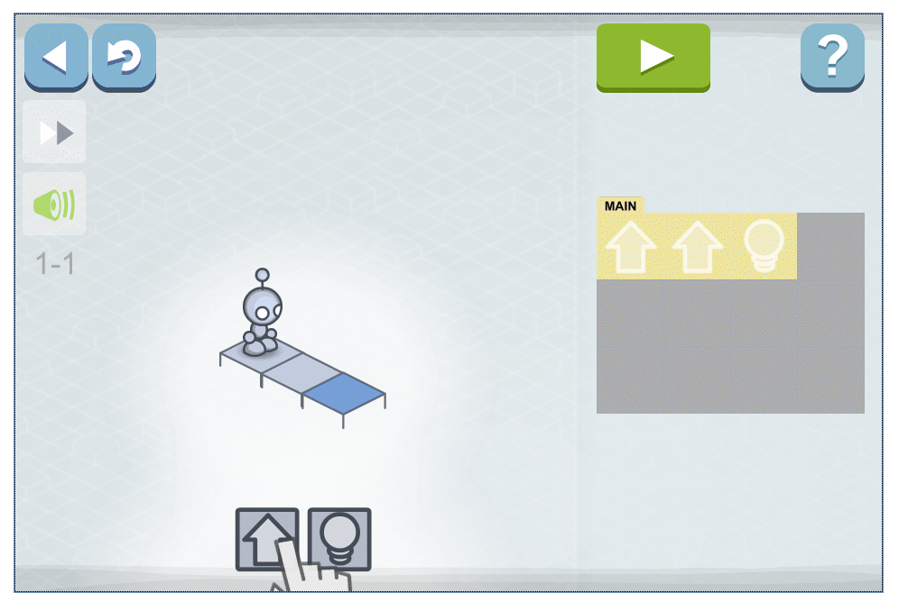
First-Second: Light Bot

Slide 9
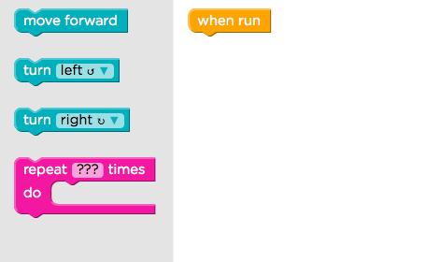
Second: Flappy Bird
Students learn how to program the flappy bird to get to the pig through a series of instruction. Students learn how to use code blocks- They will understanding loops and be able to use repeat blocks to run their code.

Slide 10
3-5th Grade
Activities Students Participate during Hour of Code

Slide 11
Starwars
Minecraft
Elsa and Anna
Scratch

Slide 12
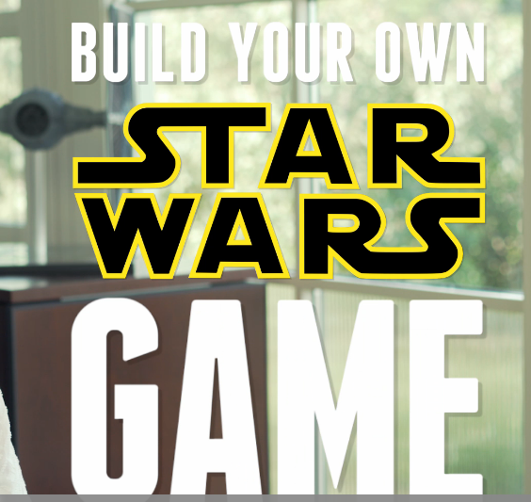
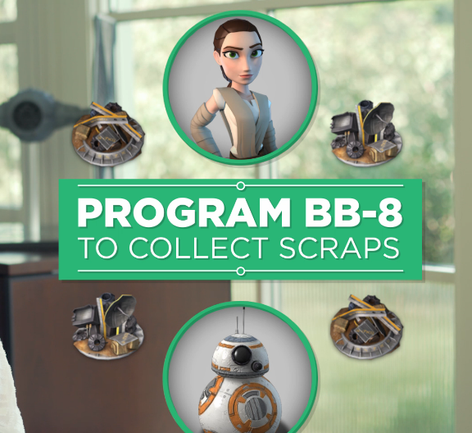
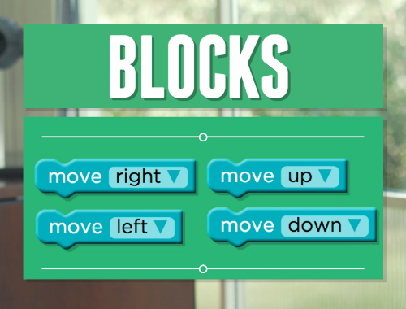
Starwars
Building your own Starwars game by programming BB-8 to collect scraps and avoid Bandits and programming R2-D2 to get Rebel Pilots and more.

Slide 13
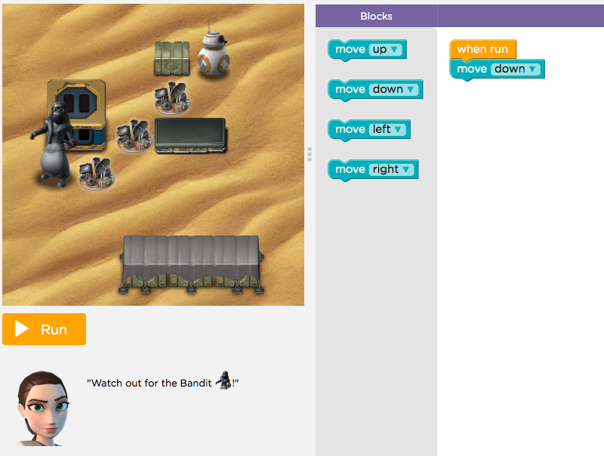

Slide 14
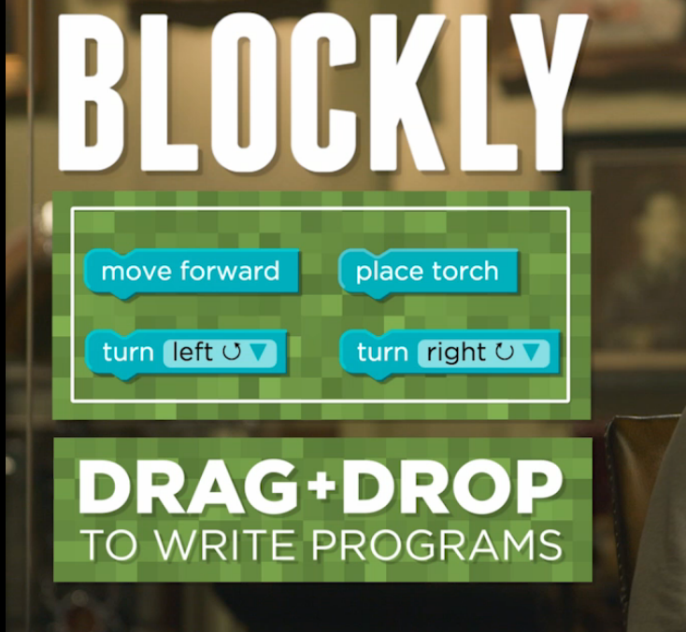
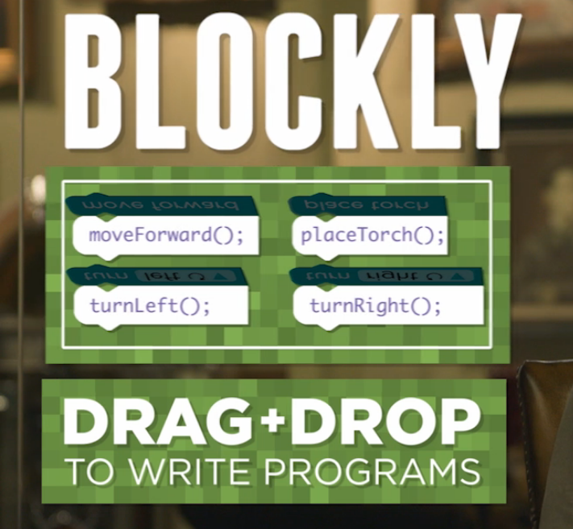
Minecraft
Using code blocks to help Steven or Alex build their world

Slide 15
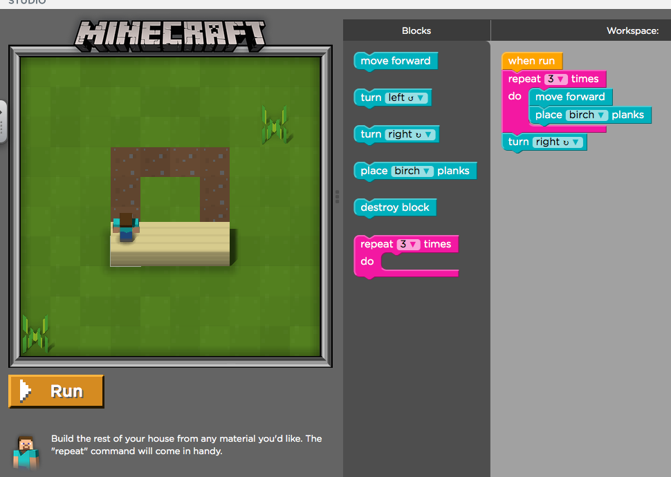
Code Blocks

Slide 16
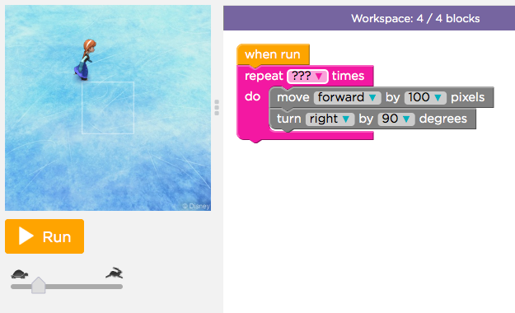
Code with Anna and Elsa
Drawing-based programming- This helps students learned how to draw through a series of code blocks. Students need to know angels and directions.

Slide 17
Cs-First and Scratch
For the last 4 weeks our fourth and fifth graders have been participating in a Google-run coding tutorial that teachers the students how to use Scratch
What is Scratch?
With Scratch, you can program your own interactive stories, games, and animations
Scratch helps young people learn to think creatively, reason systematically, and work collaboratively — essential skills for life in the 21st century.
https://scratch.mit.edu/about/

Slide 18
Creating animations through…
Fourth Grade: Storytelling
Fifth Grade: Music and Sound

Slide 19
Links for Parents
K-2nd Grade
3-5th Grade
Code.org
Course 1: Flappy Bird
Course 2: Flappy Bird
Tinker
Lightbot
Code.Org
Starwars
Minecraft
Elsa and Anna
Cs-First
Scratch

Slide 20
Thank You!

